Slide 1
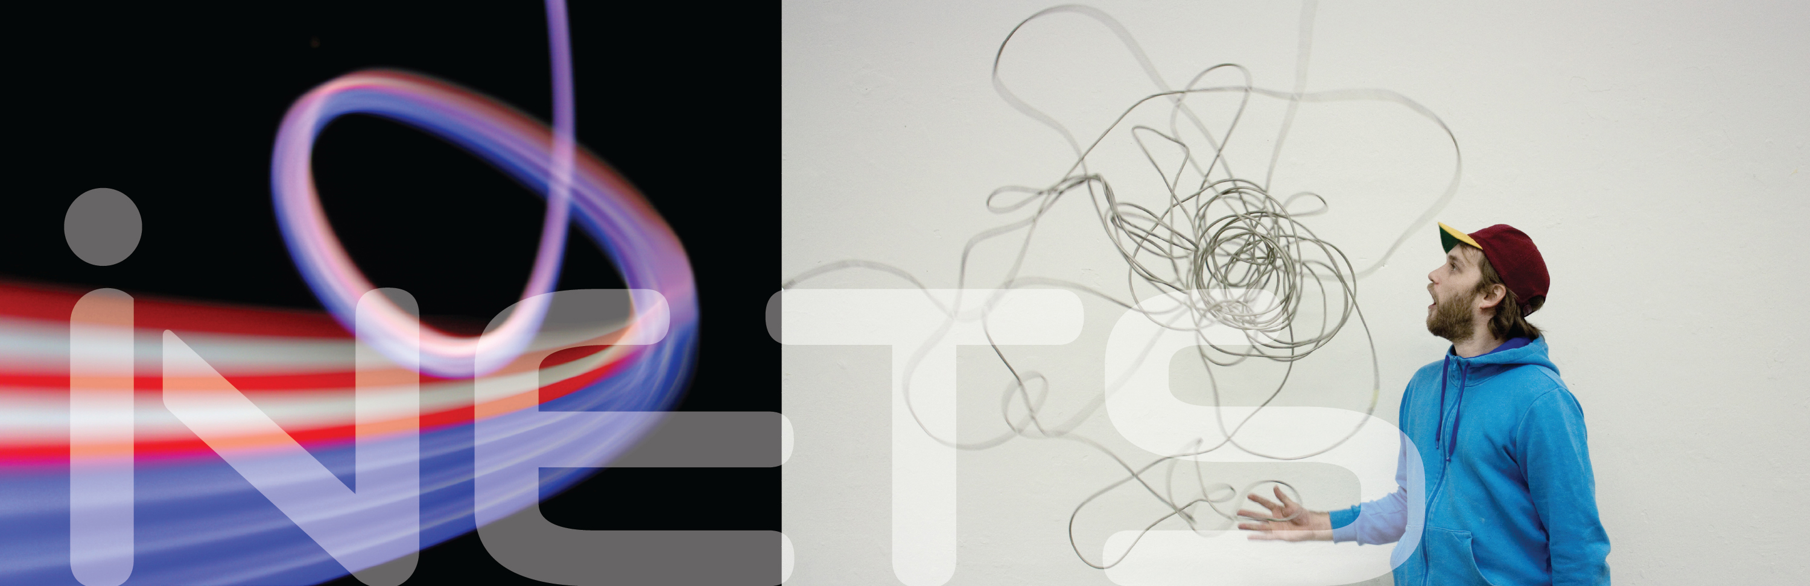
Mobile Phone Motion & Usage Classification Midterm Presentation Alexander Gladis
Notes:
M

Slide 2
Contents
G.O.L.L.U.M.
Recap on the institute project
Motivation for automated phone usage classification
Changes & improvements to the framework since then
Discussion of machine learning techniques
Supervised vs. unsupervised learning
Feature extraction
Current state of development
Future work

Slide 3

Recap: G.O.L.L.U.M.
Notes:
A

Slide 4
Approach
Development of Android app (Java)
Background service while user performs everyday tasks
Recording of sensors and metadata
Export to PC and off-line analysis (Python)
→ Determine feasibility of directional radio on a per-scenario basis
Notes:
A

Slide 5
During the institute project
Flexible framework for logging and analysis of
Sensor data (accelerometer, gyroscope, …)
Meta data (screen on/off, incoming calls, …)
Designed to be easily extensible
Notes:
A

Slide 6
Motivation
We do not want to analyze everything!
Most interesting scenarios for millimeter wave radio / directional radio:
Active phone usage
High upload/download speeds
YouTube
Video telephony
Translatorial phone movements should be recognizable:
No translation: adapt only to rotations
With translation: adapt also to movement relative to cell tower
Notes:
A

Slide 7
Motivation
Automatic classification of phone usage scenarios
Various different machine learning techniques available
Familiarize with the most commonly used techniques
Select the ones best suited for our requirements
Evaluate selected techniques
Requirement: training dataset
Usually the bigger the better
People need to perform a given set of usage scenarios
Very tedious work
Notes:
A

Slide 8
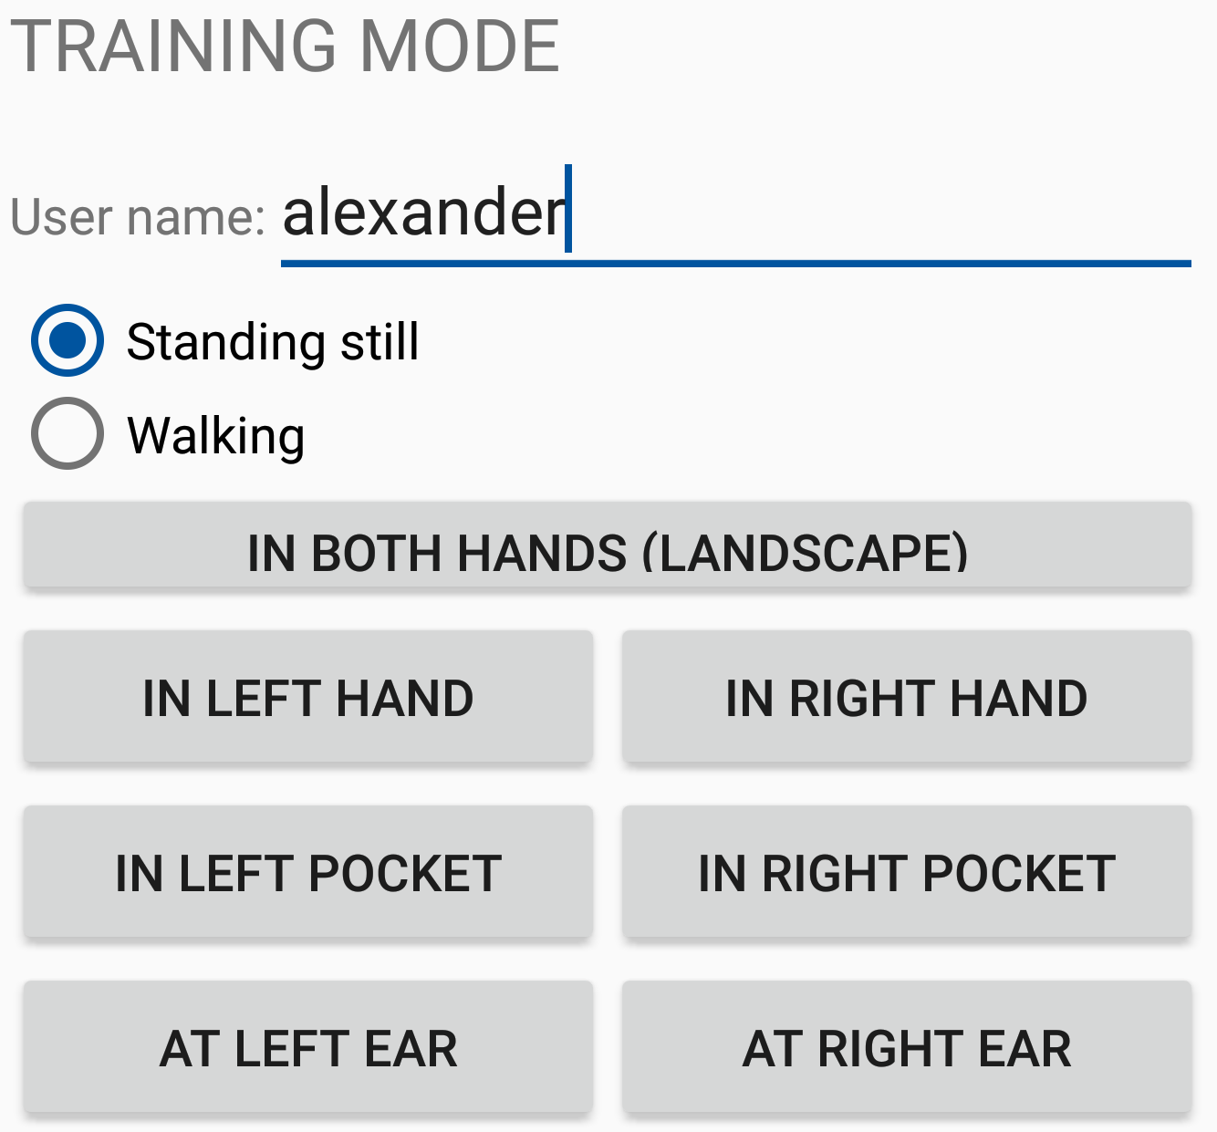
Important changes to the framework
Logging of a lot more sensors and events
WiFi / mobile data traffic statistics
Raw accelerometer / gyroscope / magnetometer data
Proximity sensor
Ambient brightness sensor
…
Improved log management
Training mode
Notes:
A

Slide 9
Machine Learning Techniques
Notes:
A

Slide 10
Supervised learning
Almost exclusively used in recent studies
Mostly with focus on classification of user motion
Approaches easily transferable to phone motion
Techniques that suit our requirements
Random Forest
K-Nearest-Neighbor (KNN)
…
Pro: Relatively small training datasets sufficient
Con: Requires a strong set of features extracted from raw data
Notes:
A

Slide 11
Unsupervised learning
Not (or at least very rarely) used in recent studies
Variants of artificial neural networks that suit our needs:
Recurrent Neural Networks
Bidirectional Neural Networks
Pro: No feature engineering
Pro: Better comprehension of temporal coherence (probably!)
Con: Requires large training datasets
Classification task becomes much more complex
Neural network needs to perform the “intelligent thinking” of feature engineering
Too large for given resource constraints
Notes:
A

Slide 12
Feature Extraction
Use a sliding window to traverse the log timeline
2s length
50% overlap
Extract features from the logged events for the window
Mean
Standard Deviation
Median
Root Mean Square
Variance
…
Classify each window
Notes:
A

Slide 13
Current State of Development
Notes:
A

Slide 14
Current State of Development
Adjust framework to new requirements ✔
Familiarize with the most commonly used ML techniques ✔
Select the ones best suited for our application ✔
Generate a training dataset (✔)
Currently around 30 full sets of the 14 different scenarios, 1min each
Engineer strong extracted features (✔)
Evaluate selected techniques
Cross-validation ✔
Manual validation against real-world data
Notes:
A

Slide 15
Evaluation (Cross-Validation)
Use e.g. 25 random sets for training and the rest for validation
High accuracy (>98%) for easily distinguishable set of scenarios
Standing; In pocket (top down)
Standing; In hands (landscape)
Standing; In hands (portrait)
Standing; At ear (top up)
Less accuracy for scenarios where user is walking
We use raw sensor data!
Accelerometer: gravity + linear acceleration
Pre-filtered data could yield better results
Notes:
A

Slide 16

Evaluation (Cross-Validation)
Worst cases:
Phone in pocket (top up) vs. at ear (top up)
Phone in bag/handbag
Notes:
A

Slide 17
Future Work
Notes:
A

Slide 18
Future Work
Two-step classification
This also covers some previously not considered cases!
E.g. phone inactive and lying on table
Screen on/off?
Screen locked?
Active usage?
No
Yes
We don’t care
where phone is
Classification
Notes:
A

Slide 19
Future Work
Evaluation of a real-world log
Run logging for hours while manually keeping track of phone usage
Compare classification result to notes
Pick some scenarios interesting for millimeter wave radio
Extract from logged data and analyze phone motion
What I cannot do due to time constraints:
Gather enough training data for unsupervised learning / neural nets
Continuously improve classification
Notes:
A

Slide 20
Thank you for your attention!
Alexander Gladis, B.Sc. RWTH
alexander.gladis@rwth-aachen.de

